Slide 1



Cancellation of Hotel Booking using EDA and classification models
Name: Chandan soul and Jaspreet Singh
Student ID 0777903 and 0778281
Professor Dr Savita Seharawat

Slide 2



01
Abstract
02
Research Question
03
TABLE OF
CONTENTS
Dataset Preprocessing
04
Exploratory Data analysis
05
Experimental Design(model)
06
Experimental design(K-fold)
07
Roc curve

Slide 3

ABSTRACT
The collection contains data from three years of daily observations of resort and city hotels from 2015 to 2017. There are 119390 rows and 32 columns in the dataset. This data collection provides booking information for a city hotel and a resort hotel, including when the reservation was made, the duration of stay, the number of people, children, and/or newborns staying, and the number of available parking spaces, among other things.

Slide 4
RESEARCH QUESTIONS
1. Check the distribution of the minimum and a maximum number of visitors?
2. Build different models to compare and select a more accurate one?
3. Use roc to review how better is our model?

Slide 5

Methodology
Initial Preprocessing
Visualization of attributes
Experimental implementation
Experimental Evaluation
Conclusion

Slide 6

DATA PREPROCESSING
Detailed data Dictionary
Missing Values
Conversion of Datatypes
Data dictionary contains detailed information about the dataset, such as the datatype of all attributes, levels, and counts corresponding to each attribute.
Then I check whether my data collection contains any null value or not, if Yes then remove those.
After removing missing values, converting datatypes from object to category and date/time and float to integer.

Slide 7

EXPLORATORY DATA ANALYSIS[EDA]

Slide 8
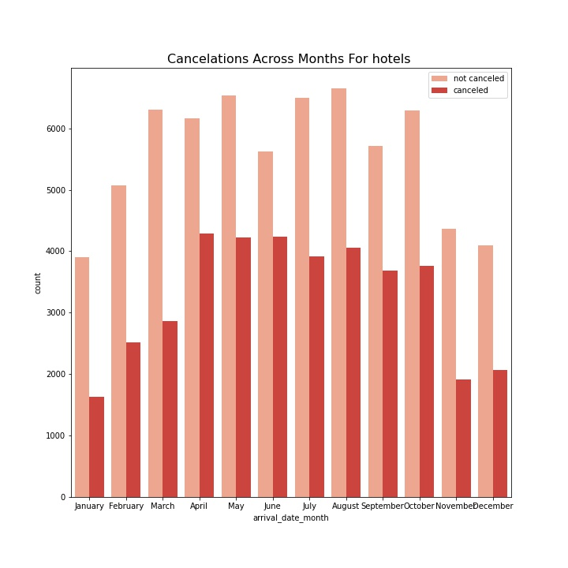
MONTHS WITH THE HIGHEST AND LEAST CANCELLATION
This represents the total number of clients who had been canceled or not canceled in three years each month. From the visual representation, we can see that not canceled clients were more as compared to cancel in the following months. The higher not canceled was in May, July and August as compared to other months.

Slide 9
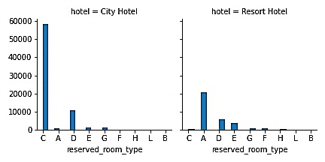
MOST PREFERABLE RESERVED ROOM TYPE
In a city hotel and resort hotel, this represents the number of counted individuals based on reserved room type. According to the comparison, people preferred room types C (the total number of count is almost 5900) and D (the total number of count is almost 1100) in city hotels over other room types; however, people preferred room types A (the total number of count is almost 2200) and D (the total number of count is almost less than 800) in resort hotels over room type C.

Slide 10
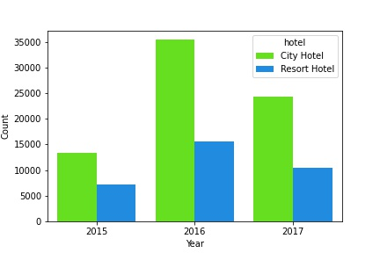
COUNTS CORRESPONDING TO HOTELS ON YEARLY BASIS
In 2016, people visited most city hotels and the least was visited Resort hotels in 2015 which was almost above 5000 and the count was in city hotels was approximately 35000 .in 2017, people were also given priority to city hotels was less than 25000 but in case of resort hotel the count was 10000

Slide 11
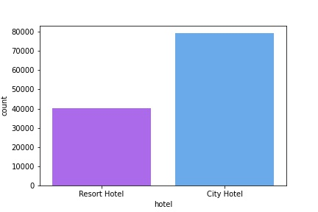
DISTRIBUTION OF CITY AND RESORT HOTELS
This shows the total number of people who visited a city hotel and a resort hotel, as we previously stated. The number of people who visited a city hotel was roughly 80000, while the number of people who visited a resort hotel was half that of a city hotel.

Slide 12
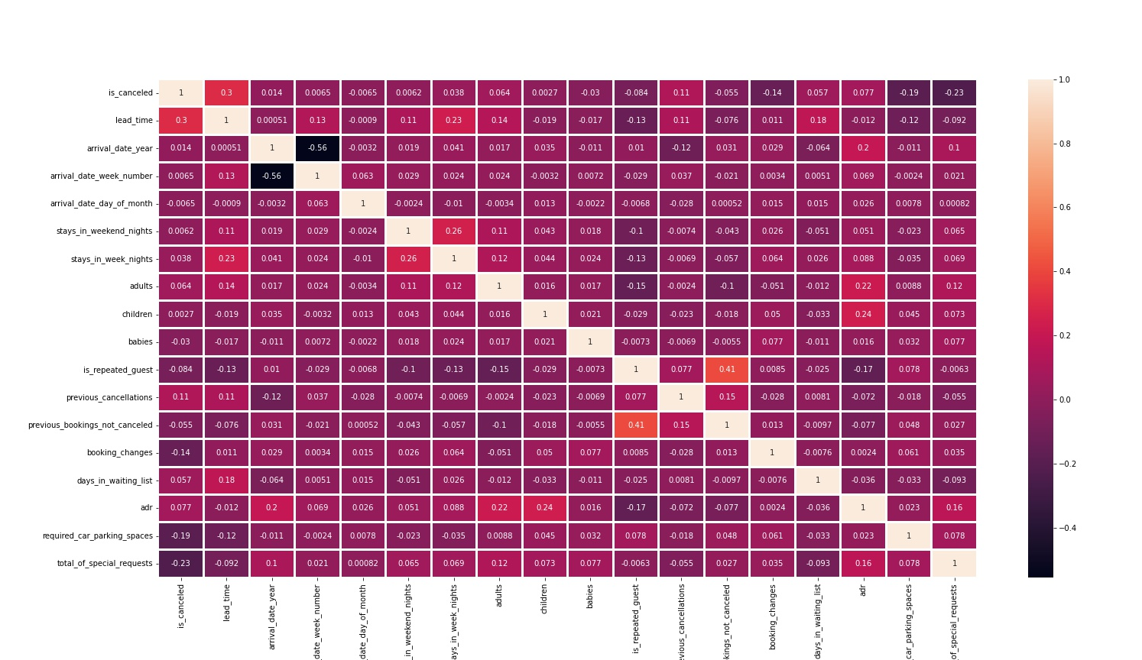
CORRELATION
In correlation we check the relationship between two attributes. The correlation coefficient is calculated by multiplying the covariance by the product of the standard deviations of the two variables. The standard deviation is a measure of how far data deviates from its mean. The covariance of two variables is a measure of how they change together.

Slide 13

EXPERIMENTAL DESIGN

Slide 14
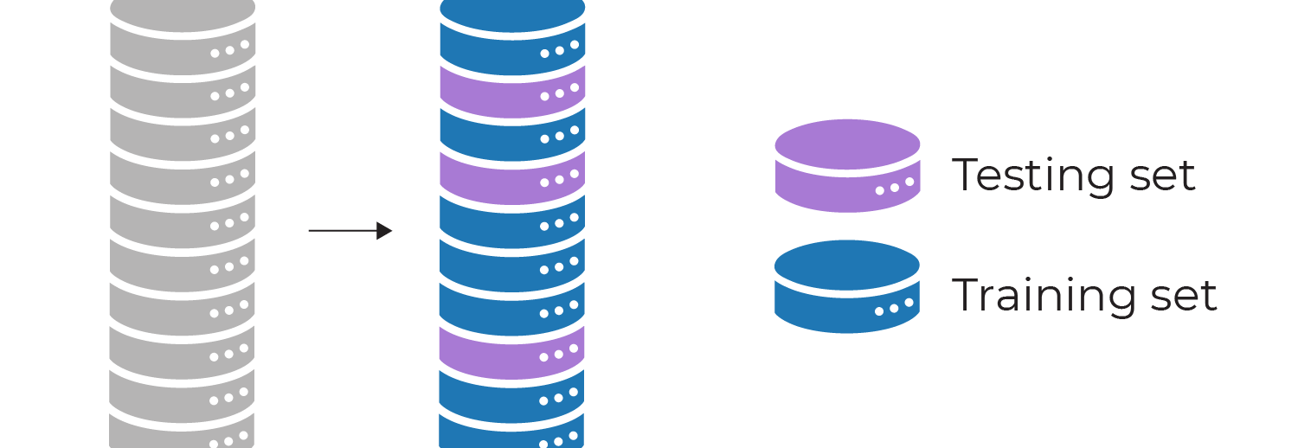
Train and test split
This is one of the best, easy, and fastest procedures to get an estimate the performance of a machine learning algorithm that is applicable to do predictions on the behalf of algorithms where the data is split into two-part tests and train
In which test size is to set dataset is set for test
And the random state is used to control the shuffling.

Slide 15

DATA NORMALIZATION
Normalization is the process of transforming real-valued numeric values into a 0 to 1 range. In machine learning, data normalization is used to make model training less sensitive to feature scale. Therefore, our models can converge to better weights, resulting in a more accurate model.

Slide 16
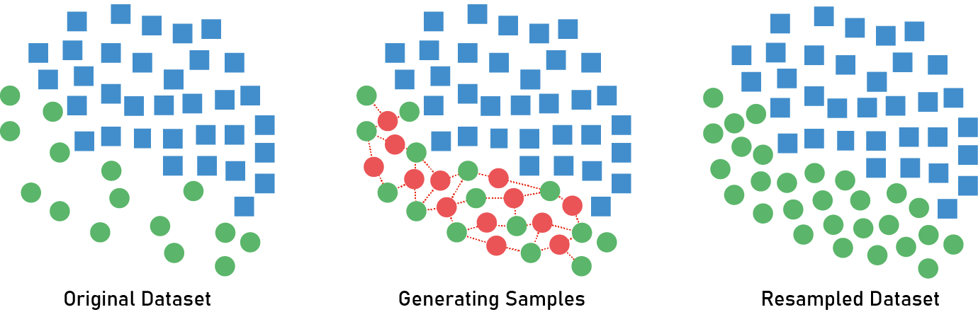
Smote
synthetic minority oversampling technique(SMOTE)
It is the technique commonly used for oversampling methods which helps us to solve imbalance obstacles
The main motive of this function is class distribution by randomly boosting the minority class. this function is used to generate the virtual training records by using linear interpolation for the minority class

Slide 17
Classification Models
Logistic regression
KNN neighbors
Naïve Bayes
Random forest

Slide 18
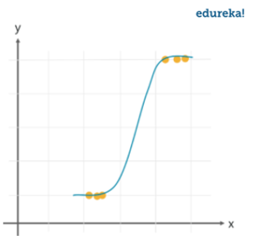
it is a classification algorithm that is used to predict based on a binary variable that contains data as 1(yes, or we can say success) or 0(no or we can say failure) If it is above 0.5 value, the answer could be yes means more possibility
Logistic regression
KNN model
K-NN algorithm assumes the similarity between the new case/data and available cases and put the new case into the category that is most like the available categories.
K-NN is a non-parametric algorithm, which means it does not make any assumption on underlying data.

Slide 19
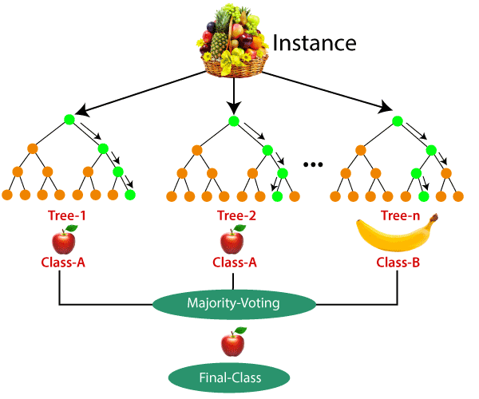
This is most used in regression and classification problems it is supervised by machine learning. In this decision, trees are built of different kind of samples and take most votes to get an average in terms of regression and classifications. An example is shown in the picture
Random forest

Slide 20
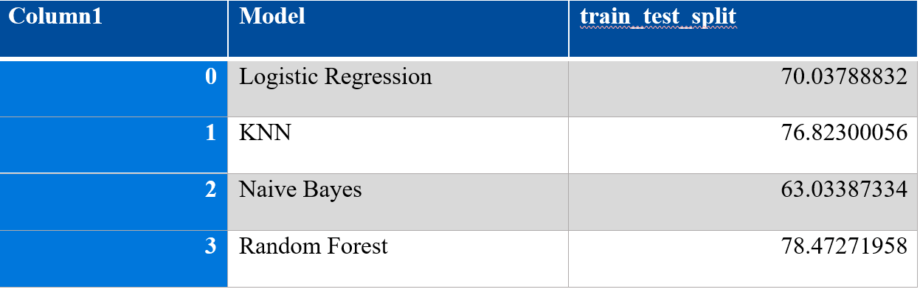
Comparing models
By comparing the model, I have noticed that random forest has the highest prediction accuracy compared to other models which are 78.47%

Slide 21

Cross-validation
Cross Validation is a strategy that includes reserving a portion of the dataset for which the model is not to be trained. You then use this instance to test your model before finalizing it.

Slide 22

Methods
K- fold cross-validation
it ensures that every observation from the original dataset has the chance of appearing in the training and test set
From the table, we observed that random forest has higher accuracy in terms of prediction. The percent is 78% in train and test split,84 and 84 in stratified folds, and RR test train split, respectively. And lower the accuracy in Naïve Bayes as compared to the rest of the model such as logistic regression and KNN.
K-fold
Stratified fold
Repeat random

Slide 23

Stratified K-fold
REPEATED RANDOM TRAIN TEST SPLIT
Shuffling and random sampling of the data set multiple times is the core procedure of repeated K-fold algorithm and it results in making a robust model as it covers the maximum training and testing operations
The stratified k-fold cross-validation is an extension of the cross-validation technique used for classification problems. It maintains the same class ratio throughout the K folds as the ratio in the original dataset

Slide 24
EVALUATION OF ACCURACIES
Column1 | Model | train_test_split | K – fold | RRTestTrainSplits_5 | Stratifiedkfold_5
0 | Logistic Regression | 70.04 | 65.02 | 71.04 | 71.01
1 | KNN | 76.83 | 78.05 | 79.43 | 80.03
2 | Naive Bayes | 63.04 | 56.08 | 56.36 | 56.34
3 | Random Forest | 78.48 | 83.01 | 84.13 | 84.81

Slide 25
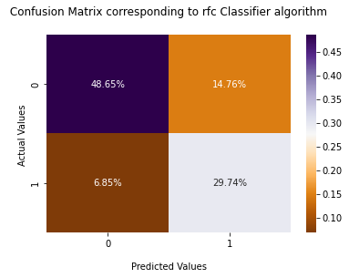
Confusion matrix
true positives (TP): These are cases in which we predicted yes, and they do have that thing.
true negatives (TN): We predicted no, and they don't have that thing.
false positives (FP): We predicted yes, but they don't have thing.
false negatives (FN): We predicted no, but they actually do have that thing.
The confusion matrix reveals that corresponding to 0 there is 48.65% of the total percentage are correct predictions however, corresponding to 1 there is 29.72% of the total proportion are correction predictions because here when our predicted value is 0 then the actual value is also 0 and when predicted values are 1 actual is also 1.

Slide 26
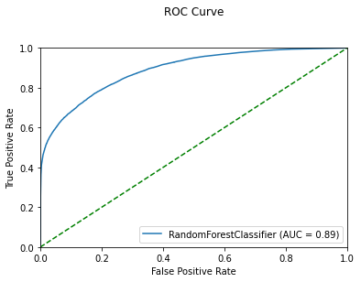
ROC CURVE
To calculate the true positive rate and the false positive rate and create a ROC( receiver operating characteristic curve) curve using the Matplotlib data visualization package: uses the Threshold we will come to know how better our model is. TPR and FPR, TPR (true positive rate) = true positive/true positive + false negative FPR (false positive rate) =false positive /false positive +true negative false-negative = if the predicted value is 0 and the actual value is 1 true positive = if predicted value and the actual value is 1 it would count as true positive
From the above Roc curve, the area under the curve score is 0.89. it shows that a random forest is an optimal classifier.

Slide 27
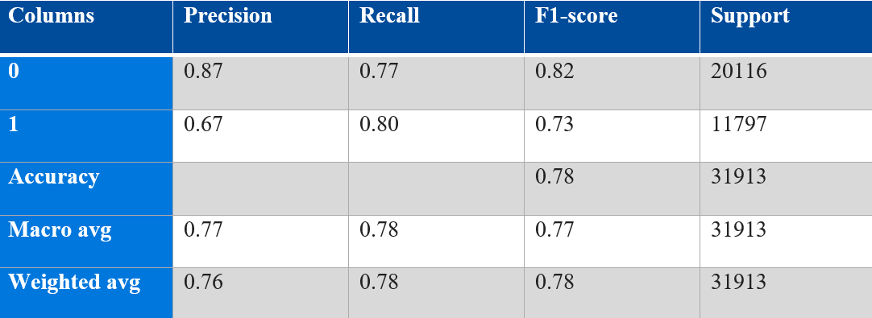
Classification Report Corresponding to An Optimal Model
Precision: It is the ratio of correctly predicted observation of the total positive predicted observation. Its formula is TP/(TP+FP).
Recall: It is the ratio of correctly predicted positive observations of actual positive observations. Its formula is TP/(TP+FN).
f1 score is weigtage average of precesion and recall

Slide 28
Conclusion
We discovered that the 'Random Forest Classifier' is the best model for our dataset because it has the highest accuracy after developing and evaluating classification models. Our goal was to predict how many people canceled or not canceled. Because the Target variable takes up such a small portion of the entire data, we can tell that there are extremely few chances of cancelation by looking at its distribution. Cross-validation is also performed using K-fold, Stratified k-fold, and Repeated Random Train tests to determine that the RFC model has the highest accuracy in each approach. Random Forest has an AUC of 0.89 on the ROC curve, indicating that it is a great model.

Slide 29

Thank you

